Slide 1
BioImage Group
Haohan Wang, Xiaobo Hu, Yiwei Li, Yucong Yang, Zhu Meng

Slide 2
Content
Vision
Pattern Design
Result Analyses
Use Case
Domain Model
Diagram
Class
Database
Reflections
Future work
Vision:
Problem
Solution
Market Analyses
Pattern Design:
Use Case
Domain Model
Diagram
Class
Database
Report
Result Analyses:
Research Question
Experiment
Data Analyses
Reflection:
Paperwork
Prototype
reflection
Future:
Recent plan
Long-term Plan

Slide 3
3 Take home messages
Marketing
Design
Research

Slide 4
Vision
Problem
Solution
Market Analyses
Pattern Design
Result Analysis
Reflections
Future work
Motivation Example

Slide 5
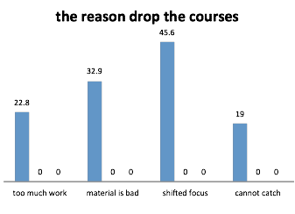
Survey
Vision
Problem
Solution
Market Analyses
Pattern Design
Result Analysis
Reflections
Future work
Chart: Reasons why students drop online courses

Slide 6
Problem
Vision
Problem
Solution
Market Analyses
Pattern Design
Result Analysis
Reflections
Future work
From more surveys, 67.9% of students cannot comprehend without feedback
Lack of Feedbacks to trigger motivation and communication for online education
Students lack of communication between each other

Slide 7
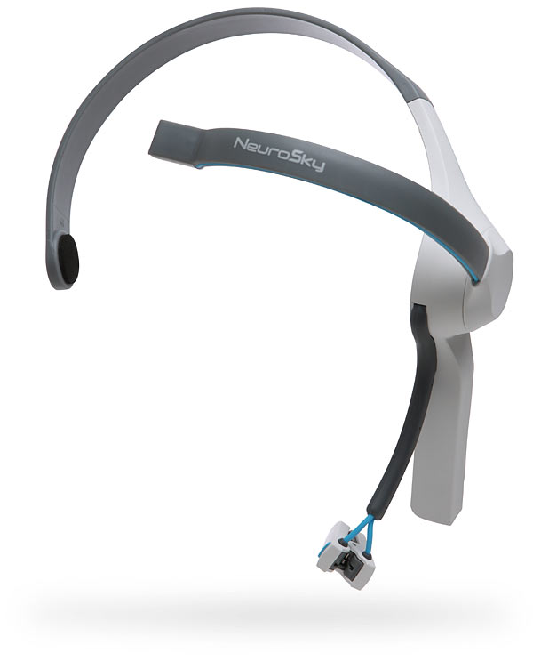
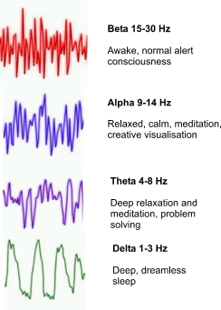
Solution
Vision
Problem
Solution
Market Analyses
Pattern Design
Result Analysis
Reflections
Future work
Using portable EEG device to detect students’ brain activity, showing concentration, meditation and confusion level as feedback for students and professors.

Slide 8
Vision
Problem
Solution
Market Analyses
Pattern Design
Result Analysis
Reflections
Future work
Feedback
Intelligent Feedback Generator
Motivation
Personal Learning Strategy Consultant and Brain Monitor
Communication
Peer Evaluation between students

Slide 9
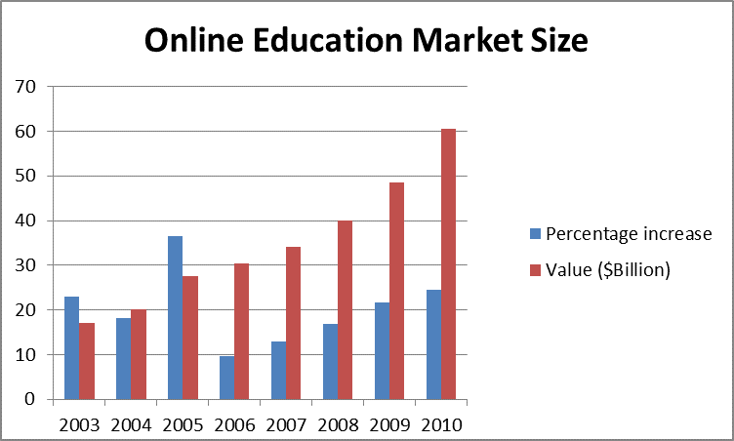
Vision
Problem
Solution
Market Analyses
Pattern Design
Result Analysis
Reflections
Future work
Market Size
Increasing online education population (About 400% in 8 years)
Online Market continues to grow steadily and represents

Slide 10
Vision
Problem
Solution
Market Analyses
Pattern Design
Result Analysis
Reflections
Future work
Business Model
Cooperation with mass open online course platform, distance education in university.
Recommend relative online courses & books basing on confusion part in online course.
Combination with Google glass
Data mining with user data.

Slide 11
3 Take home messages
Vision
Pattern Design
Data Analyses
Reflections
Future work
✔ Marketing
Design
Research

Slide 12
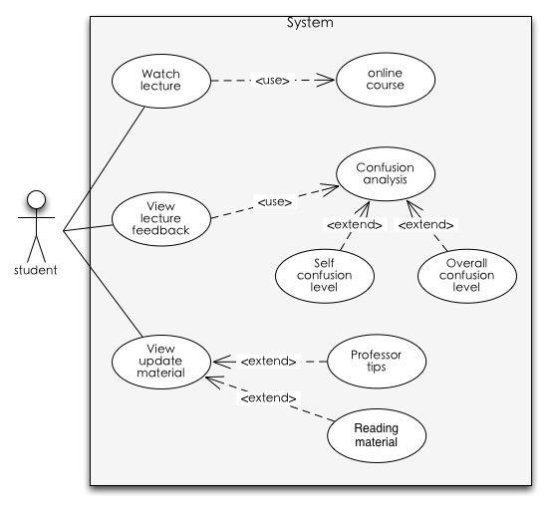
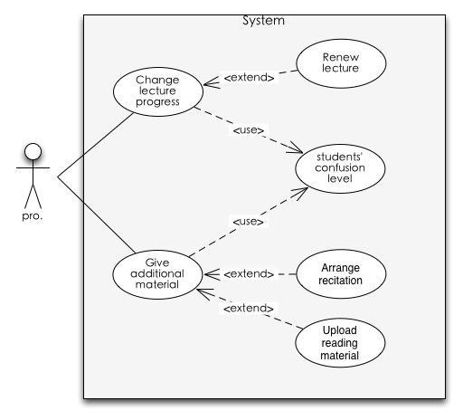
Use Case
Vision
Pattern Design
Use Case
Domain Model
Diagram
Class
Result Analyses
Reflections
Future work

Slide 13
Requirements
Vision
Pattern Design
Use Case
Domain Model
Diagram
Class
Database
Result Analyses
Reflections
Future work
View video successful scenario:
1. User logs in the system with student privilege
2. System checks connection with EEG device and open up an adapter that reads package from connection with a manually-configured frequency
3. System pop up a tutorial selection panel
4. User selects the tutorial to learn
5. System fetches mindwave data from EEG while the user is learning, analyzes and displays the data. The data is temporally stored in cache
6. After the student finishes the tutorial, all logged data will be dumped into database. Only data that are not be overridden will be used to generate report of study
7. The student gets his study report and confirm that he finish the learning
8. The report is dumped into database. System close all connections

Slide 14
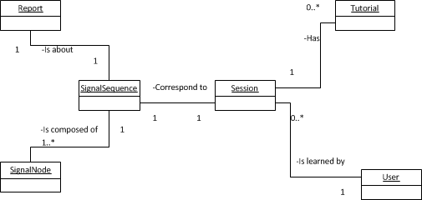
Domain Model

Slide 15
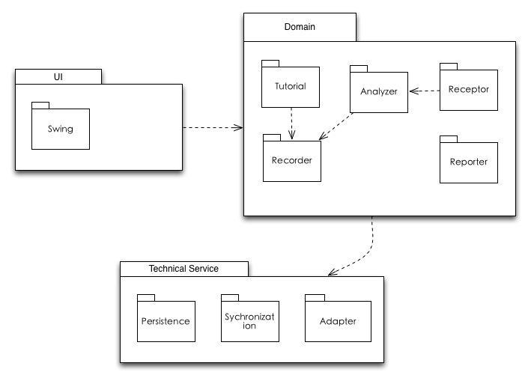
Package Diagram
Vision
Pattern Design
Use Case
Domain Model
Diagram
Class
Database
Result Analyses
Reflections
Future work

Slide 16
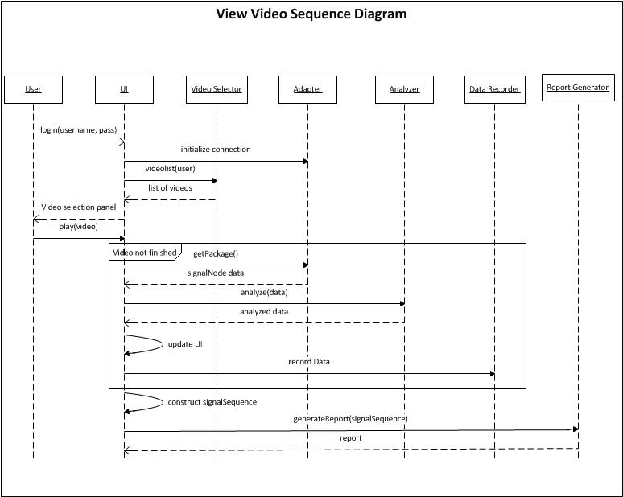
Sequence Diagram

Slide 17
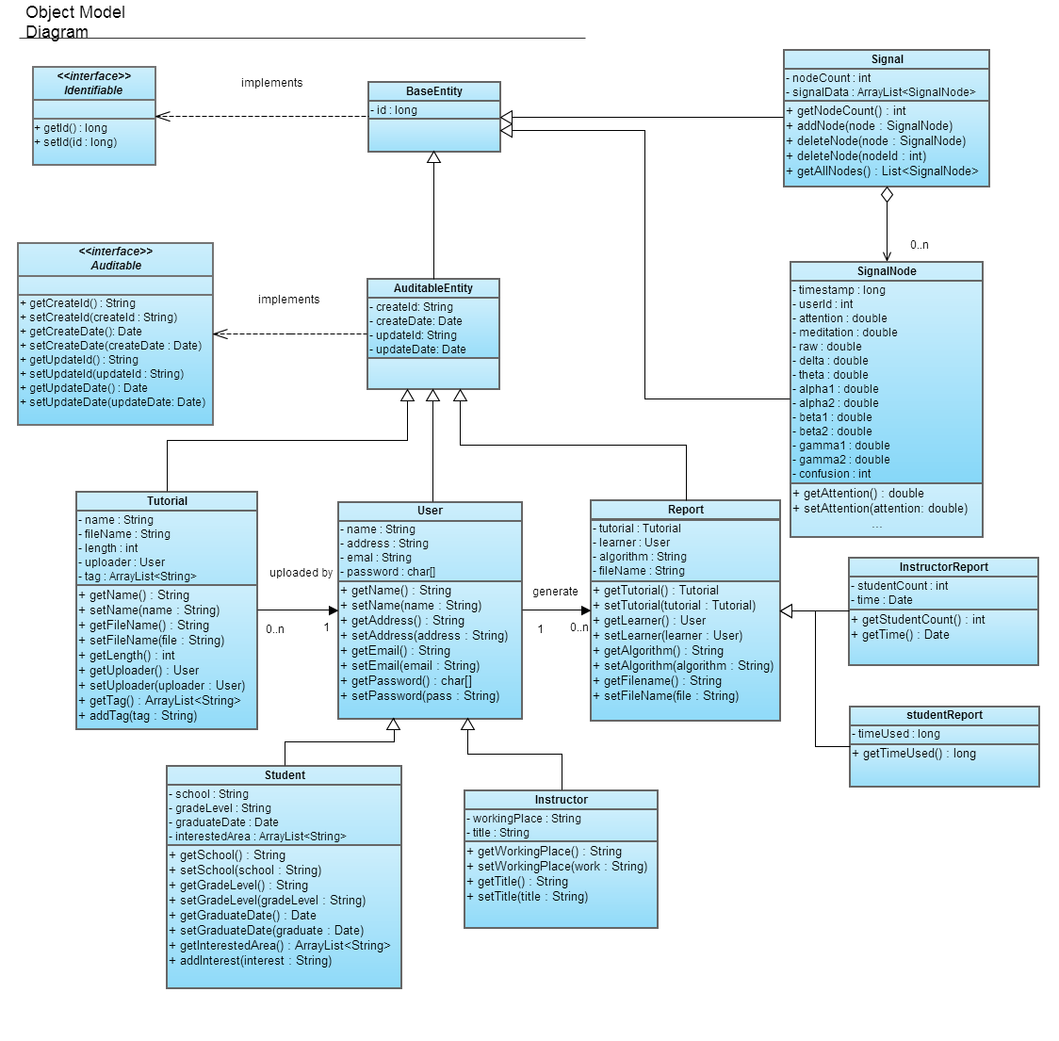
Class Diagram

Slide 18
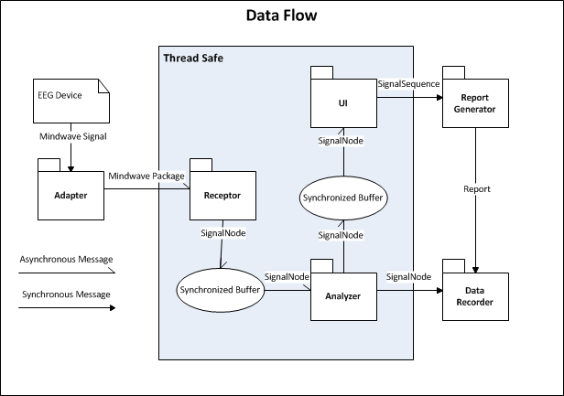
Data Flow

Slide 19
Class Design
Vision
Pattern Design
Use Case
Domain Model
Diagram
Class
Database
Result Analyses
Reflections
Future work
Analyzer:
Use of Strategy Pattern to facilitate choosing different implementation of algorithms in RUNTIME. So that output from different classifier can be combined to have better performance
Report Generator:
We can have many types of reports depending on what the user want. So we can use Factory Pattern which is a Singleton that create different reports based on user input

Slide 20
Vision
Pattern Design
Use Case
Domain Model
Diagram
Class
Database
Result Analyses
Reflections
Future work
Synchronized Buffer is designed to be implemented using LinkedBlockingDeque which supports Producer-Consumer Pattern
Receptor, Analyzer and UI are in its own thread and are implemented thread-safe
The buffer together with multi-threading ensure the synchronization even when different components are of different update frequency

Slide 21
Vision
Pattern Design
Use Case
Domain Model
Diagram
Class
Database
Result Analyses
Reflections
Future work
Persistence
User.db
Tutorial.db
SignalNode.db
Report.db

Slide 22
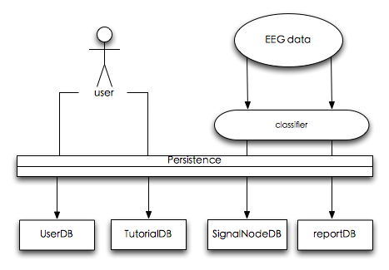
Vision
Pattern Design
Use Case
Domain Model
Diagram
Class
Database
Result Analysis
Reflections
Future work
Persistence work flow

Slide 23
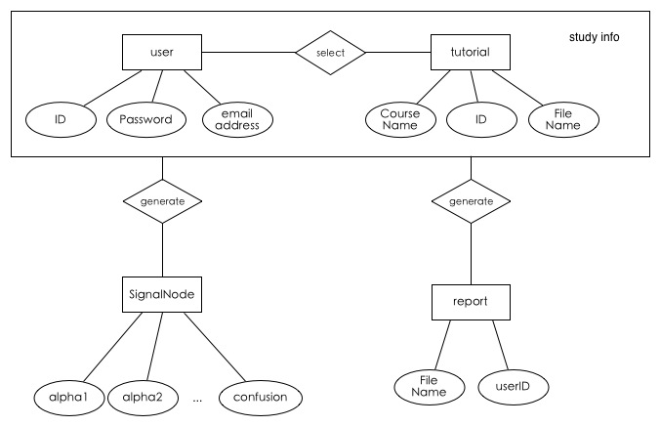
ER graph
Vision
Pattern Design
Use Case
Domain Model
Diagram
Class
Database
Result Analysis
Reflections
Future work

Slide 24
3 Take home messages
Vision
Pattern Design
Result Analyses
Reflections
Future work
✔ Marketing
✔ Design
Research

Slide 25
Reporter

Slide 26
Vision
Pattern Design
Result Analysis
Research Question
Exp.
Data Analyses
Reflections
Future work
Research Question
Can EEG detect confusion?
Can EEG detect confusion better than human observers?

Slide 27
Vision
Pattern Design
Result Analysis
Research Question
Exp.
Data Analyses
Reflections
Future work
Experiment Design
Video Preparation:
Entry level video 2min*10
Expert level video 2min*10

Slide 28
Experiment Design
Experiment Process
Session
Rate
Watch
Rest
Observe & Rate
Session

Slide 29
Vision
Pattern Design
Result Analysis
Research Question
Exp.
Data Analyses
Reflections
Future work
Experiment Process
Collect data from ten students
Ten sessions
roughly 120 signals
binary label of confusion
score of confusion level of student's feeling
score of confusion level by three observers

Slide 30
Vision
Pattern Design
Result Analysis
Research Question
Exp.
Data Analyses
Reflections
Future work
Data Analysis
Preprocessing
remove leading 30 seconds and ending 30 seconds
average the score of obeservers
Model
student-specific
student-independent

Slide 31
Vision
Pattern Design
Result Analysis
Research Question
Exp.
Data Analyses
Reflections
Future work
Data Analysis
Algorithm
SVM( linear kernel)
Input:
All brain wave signal
Each signal
Output:
Binary classification
Gaussian Naïve Bayes:
Input:
Raw brain wave signal
Each video session
Output:
Binary classification

Slide 32
Vision
Pattern Design
Result Analysis
Research Question
Exp.
Data Analyses
Reflections
Future work
Data Analysis
Criteria
Classifier
Accuracy (10 fold cross validation)
Statistical significance
Prior work
Mostow et al in AIED 2012
60-70% accuracy on discriminating reading difficulty
Compared with human
correlation

Slide 33
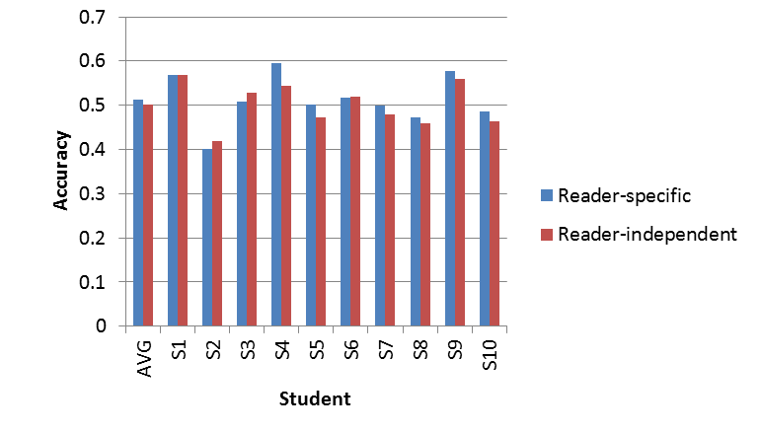
Data Analysis
SVM (linear kernel)

Slide 34
Vision
Pattern Design
Result Analyses
Research Question
Exp.
Data Analyses
Reflections
Future work
Data Analysis
Result:
Student-specific Model:
Accuracy: 51.2%
Statistical significance: 0.448
Student-independent Model:
Accuracy: 50.6%
Statistical significance: 0.94

Slide 35
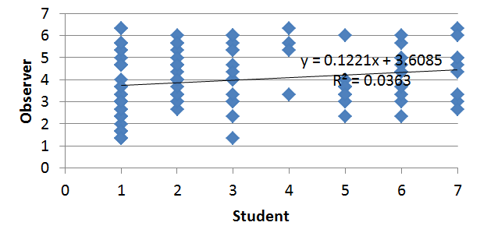
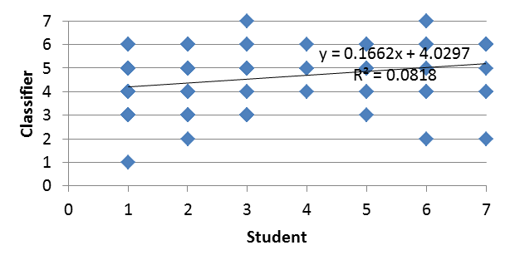
Data Analysis
Correlation
0.19
0.29

Slide 36
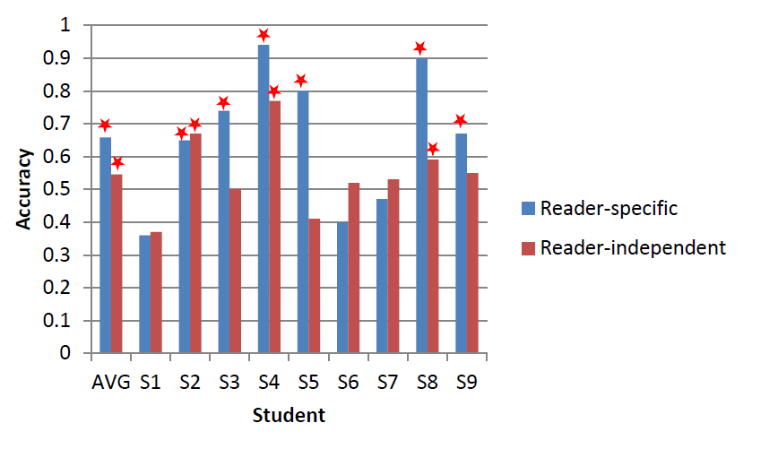
Data Analysis
Guassian Naive Bayse

Slide 37
Vision
Pattern Design
Result Analyses
Research Question
Exp.
Data Analyses
Reflections
Future work
Data Analysis
Result:
Student-specific Model:
Accuracy: 66%
Statistical significance: 0.5
Student-independent Model:
Accuracy: 55%
Statistical significance: 0.5

Slide 38
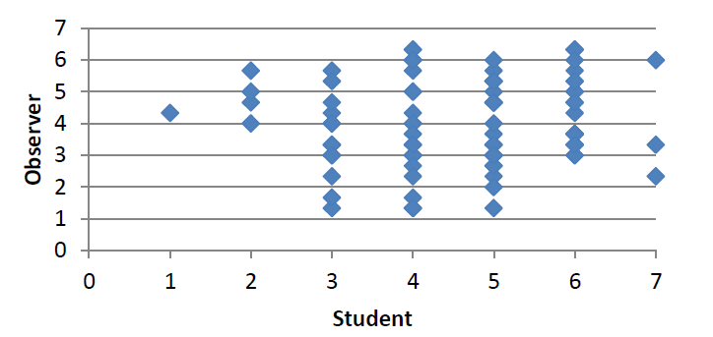
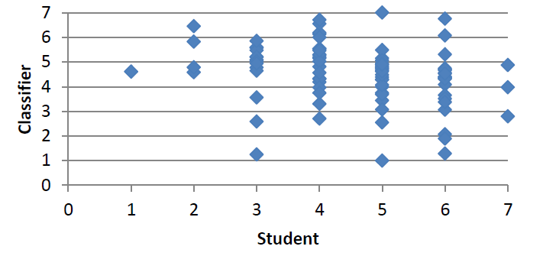
Data Analysis
Correlation
0.08
0.37

Slide 39
Vision
Pattern Design
Result Analyses
Research Question
Exp.
Data Analyses
Reflections
Future work
Discussion
“Confusion” may not be confusion
Feasibility to generalize across people

Slide 40


Contribution
A paper submitted to AIED MOOC workshop:
Using EEG to improve Massive Open Online Courses Feedback Interaction

Slide 41
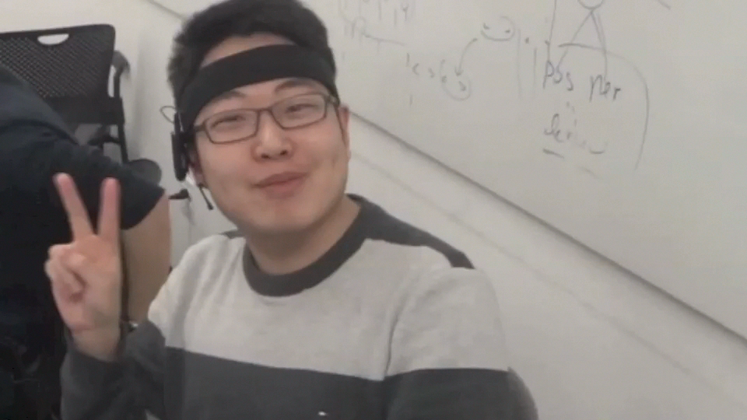
Project Reflection:prototype
Prototype:user experience video:

Slide 42
Project Reflection: Milestone Timeline
research
Prepare |  |  |  |  |  |  | Round 1 |  |  |  |  |  |  |  | Round 2 |  |  |  |  |  | Round 3
week1 |  | week2 |  | week3 |  | week4 |  | week5 |  | week6 |  | week7 |  | week8 |  | week9 |  | week10 |  | week11 |  | week12 |  | week13 |  | week14
software
read papers which related to our projects
Experiment 1;
Data 1;
Analyze 1
Experiment 2
Data 2
SVM
SVM train and test
Data 3;
model1
Demo
Data 4
Experiment 3
Data 5
Experiment 4
Data 6
WORKSHOP
final report
software design pattern:
Use case;
Each layers;
Information flow;
data logging system
Obiect Model Package
1. UI
2.Persistence
1.domain layer
2.VLCJ framework
Visualizer UI
1.database
2.analyzer
Demo
Receptor
Recorder
Reporter
LinkedBlockingDeque
FileUpload
new pipeline
final report

Slide 43
Project Reflection: what we learn
Vision
Pattern Design
Result Analyses
Reflections
Future work
for the experiment design:
set the baseline of experiment.
design the experiment.
collect useful data.
filter the data.
for the analyze part:
use cross-validation.
use different algrithom.
compare the results.
for the software design part:
design the use case.
design the information flow.
accomplish the work from one milestone to the other milestone.
use Agile to manager our project.
use the design pattern to improve the coherence from module to module.
use LinkedBlockingDeque to solve the different update pace between different data.

Slide 44
Project Reflection: where we made mistakes
Vision
Pattern Design
Result Analyses
Reflections
Future work
for the research part:
1.we arrange the videos in a certain sequence
changed-------- random
2. we did not add relaxing period
changed--------add
for the software part:
use cross-validation.
use different algrithom.
compare the results.

Slide 45
Project Reflection: things need to do
Vision
Pattern Design
Result Analyses
Reflections
Future work
for the research part:
we did not record the relaxing period
we label all the signals in one video the same
for the software part:

Slide 46
Future perspective: Recent plan
Vision
Pattern Design
Result Analyses
Reflections
Future work
Recent plan technology part:
1. improve the precise
2. collect more data
3. cluster the people by their age, gender
4. Do the data mining according to our data to find out other function that can contribute to the research or application area
5.Store the data into the database which will be convenient for teachers or students to use
6. web-based
Recent plan business part:
1. Attend some competitions that can spread our idea to whom want to collaborate.
2. Connect with our target costumers: Coursera

Slide 47
Future perspective: long time plan
Vision
Pattern Design
Result Analyses
Reflections
Future work
Recent plan technology part:
1. Build the platform which can has other function such as auto graded
2. Build the personalized education to select the course for students
3. Can be connected with google glass or other equipment.
Recent plan business part:
1. Add the recommendation course in our report
2. Cooperate with some other company such as Google glass

Slide 48
3 Take home messages
Vision
Pattern Design
Result Analyses
Reflections
Future work
✔ Marketing
✔ Design
✔ Research

